Slide 1
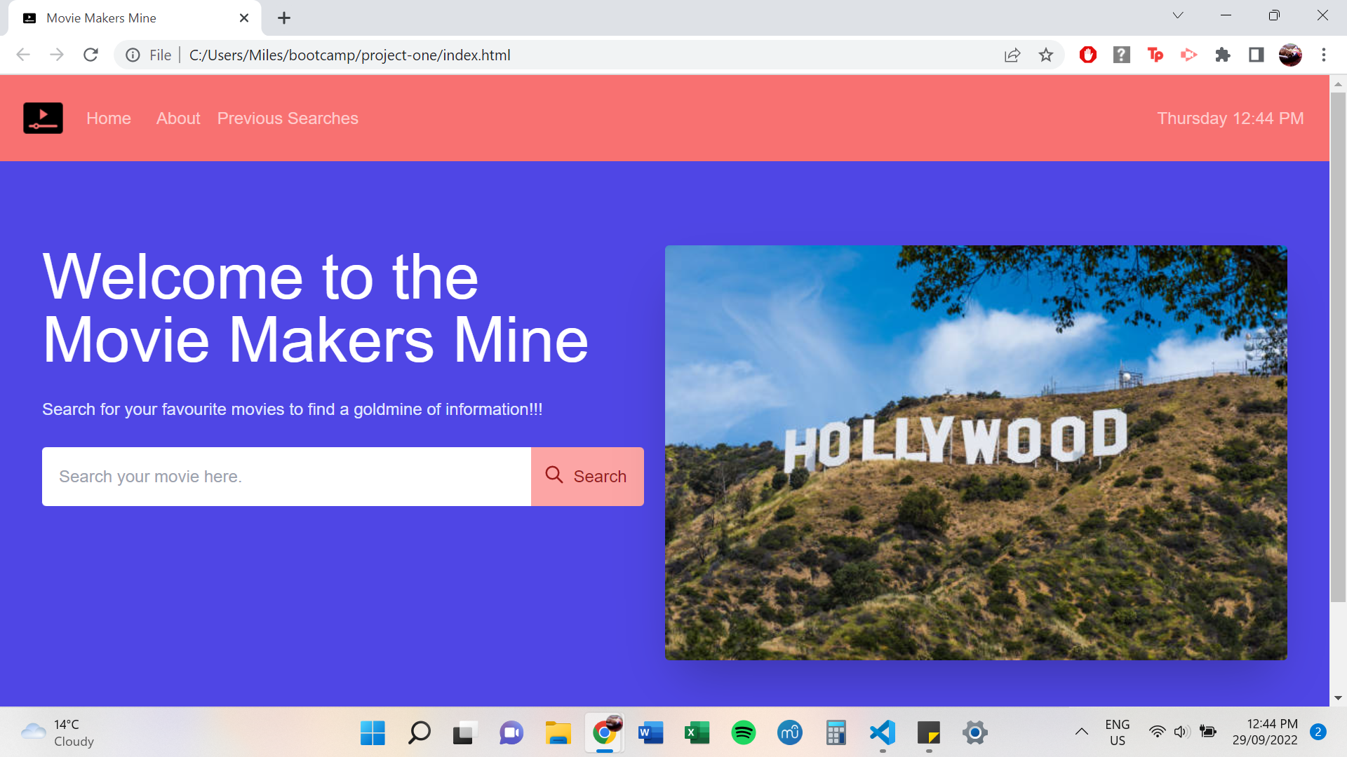
Movie Makers Mine

Slide 2
Pitch
Have you ever been to a movie and thought this soundtrack is amazing, but I wish I knew how to find it?
A lot of movie databases only give you information about the movie but not the music
Our database provides a link between the Movie and the Soundtrack

Slide 3
Concept
The purpose of this project was to create a one-stop-shop for movie enthusiasts to find a goldmine of information about their favourite movies. Users can search a movie title to find information about the plotline and ratings.
User Story:
As a movie enthusiast I want to search movie titles on one webpage so that I can receive a mine of information about its general plot, audience scores and other interesting information all in one place

Slide 4
Process
Technologies used were Tailwind CSS, HTML, Javascript, DAY JS
Breakdown of tasks and roles
Search History
Debugging
Modals
Javascript
Applying CSS
Readme
Project lead, Developers
The challenges
Syntax
Debugging
How to navigate through APIs
Javascript language
Successes
Cleaning those bugs
Produce a working Website/app
Splitting up tasks
Working well together
Working together as a team everyday
Open and talk through things

Slide 5
Demo

Slide 6
Future Development
Movie News
Soundtracks
Movie Quotes
Awards
Social and Forum
Login & sign up page

Slide 7
Links
https://breakfireaus.github.io/Movie-and-music-database/
https://github.com/breakfireaus/Movie-and-music-database.git

